Slide 1



LOAN PREDICTION
PROJECT 4

Slide 2
Group Members
Member | Tasks & Responsibilities
Khin Kyaw | Machine Learning Model and Presentation
Minh Tran | Flask Application, Web Page and Presentation
Rohan Liyanage | Flask Application, Web Page and Presentation

Slide 3

Introduction
The two critical questions in the lending industry are, A) What type of the borrower we are going to serve? B) Considering the borrower’s risk, Could we lend to this borrower?
Lenders provide loans to borrowers in exchange for repayment with capital and interest. Means the lender only makes profit if the borrower pays off the loan in full on time. However, if borrower doesn’t repay the loan, then the lender loses money.
So, for this project We’ll be using publicly available data from www.kaggle.com and www.lendingclub.com
The data covers the approximately 9,578 loans funded by the platform between year 2007 and 2010. Considering all, we’ll predict if the borrower will repay the loan by its mature date or not.

Slide 4


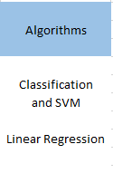


What we used

Slide 5

Main Steps
Machine Learning
Preliminary Data Processing
Model Testing
Web Page

Slide 6
Data Sources
Kaggle
lendingclub.com

Slide 7
Description of each feature in the data set
credit_policy: 1 if the customer meets the credit underwriting criteria of LendingClub.com, and 0 if not.
purpose: The purpose of the loan such as: credit card, Educational, debt consolidation. Home improvement etc.
int_rate: The interest rate of the loan (proportion).
installment: The monthly installments ($) owed by the borrower if the loan is funded.
log_annual_inc: The natural log of the annual income of the borrower.
dti: The debt-to-income ratio of the borrower.
fico: The FICO credit score of the borrower.
days_with_cr_line: The number of days the borrower has had a credit line.
revol_bal: The borrower’s revolving balance.
revol_util: The borrower’s revolving line utilization rate.
inq_last_6mths: The borrower’s number of inquiries by creditors in the last 6 months.(no of credit checks)
delinq_2yrs: The number of times the borrower had been 30+ days past due on a payment in the past 2 years.
pub_rec: The borrower’s number of derogatory public records.
not_fully_paid: indicates whether the loan was not paid back in full (the borrower either defaulted or the borrower was deemed unlikely to pay it back).

Slide 8

Machine Learning
Create dummy variables from the feature “purpose” since its nominal (not ordinal) categorical variable.
Split the data into training set and test set.
Fit selected model by using the training data
Use the testing data to evaluate the model for the classification report
Select the best model for the data set

Slide 9
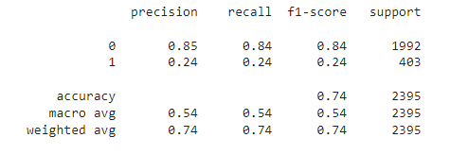
Decision Tree Classifier

Slide 10
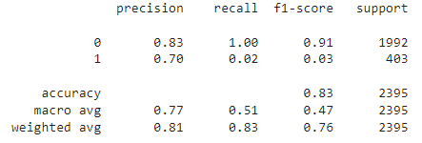
Logistics Regression Model

Slide 11
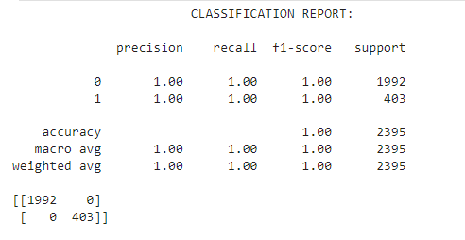
SVM

Slide 12
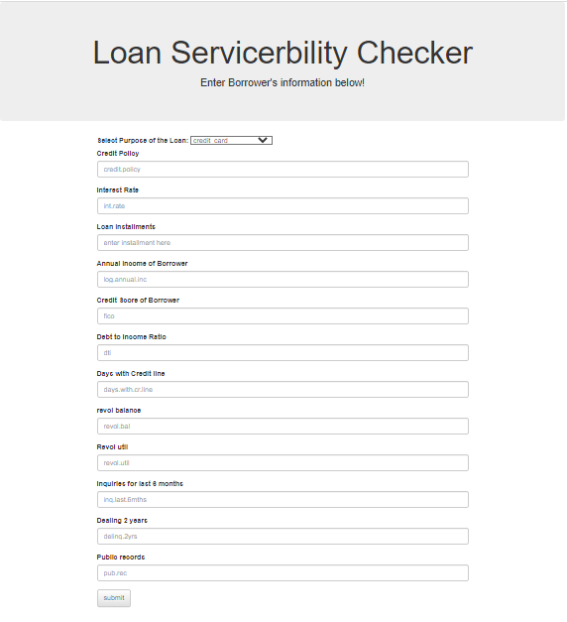
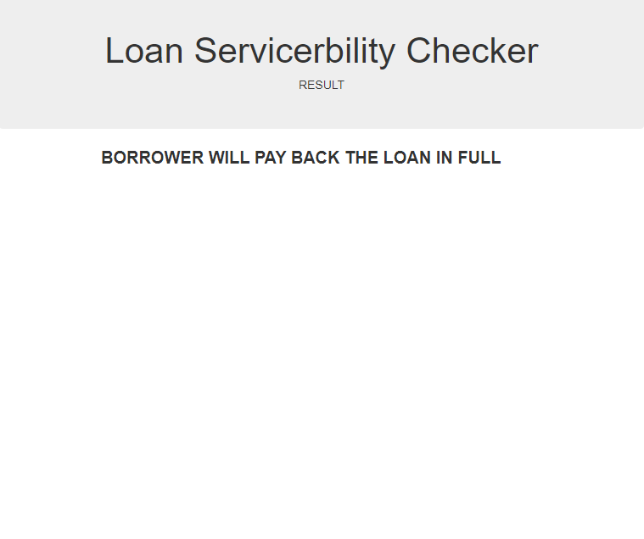
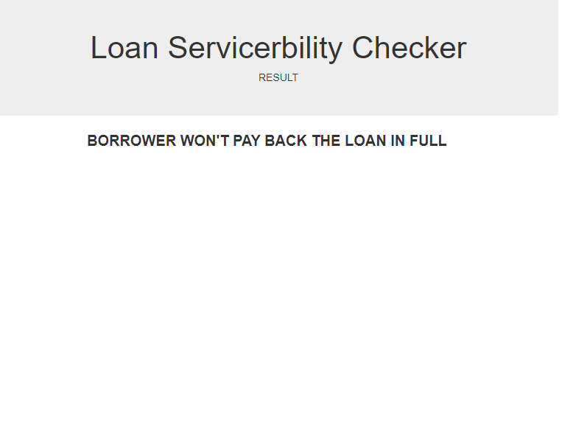
Form html and Outcome html

Slide 13


Conclusion
We used three machine learning models, Decision Tree Classifier, Logistics Regression and Support Vector Machine (SVM).
Out of three models, SVM model is recommended compared to other models due to much higher precession and recall score for default loan and successful loans. Means this is more accurately classify all for both predictions.
Overall, SVM has dominant performance in accuracy. This is useful if we want to use the model to determine if a loan is potentially default or not.
Classification problems in the real world are imbalanced. Also, data sets may have missing values. There is no definitive guide of which algorithms to use given any situation. What may work on some data sets may not work on others. So, Still there could be incorrect predictions such as false positives and false negatives.

